Slide 1
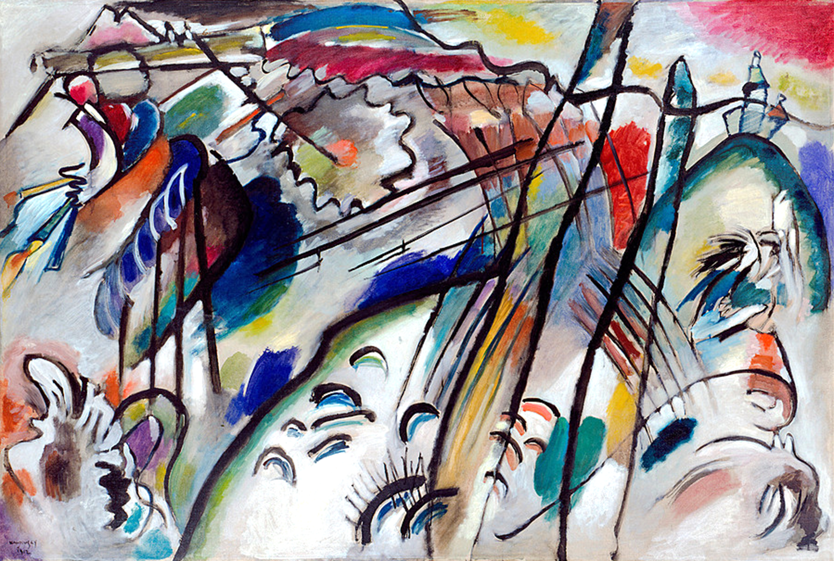
GERMAN EXPRESSIONISM
History of Modern Art
BFA-III (Visual Arts)
Course Incharge: Ms. Sidra Liaqat
Institute of Design & Visual Arts, LCWU

Slide 2
Two prominent groups raised which define this movement in a more solvable ways are
Die Brücke ( The Bridge).
Der Blaue Reiter ( The Blue Rider).

Slide 3
Influences
With its subjective emotions, its roots lay in
The works of Vincent Van Gogh (Post-impressionist).
Symbolism
Synthetism (Paul Gauguin) (Nabis).
In its experimentation with the power of pure color, it also related to Neo Impressionism and Fauvism.

Slide 4
Die Brücke (The Bridge)
Four German students of architecture founded the group
Ernst Ludwig Kirchner (1880-1938) (leader of the group)
Karl Schmidt-Rottluff (1884-1976)
Fritz Bleyl (1880-1938)
Erech Hackel (1883-1970)

Slide 5
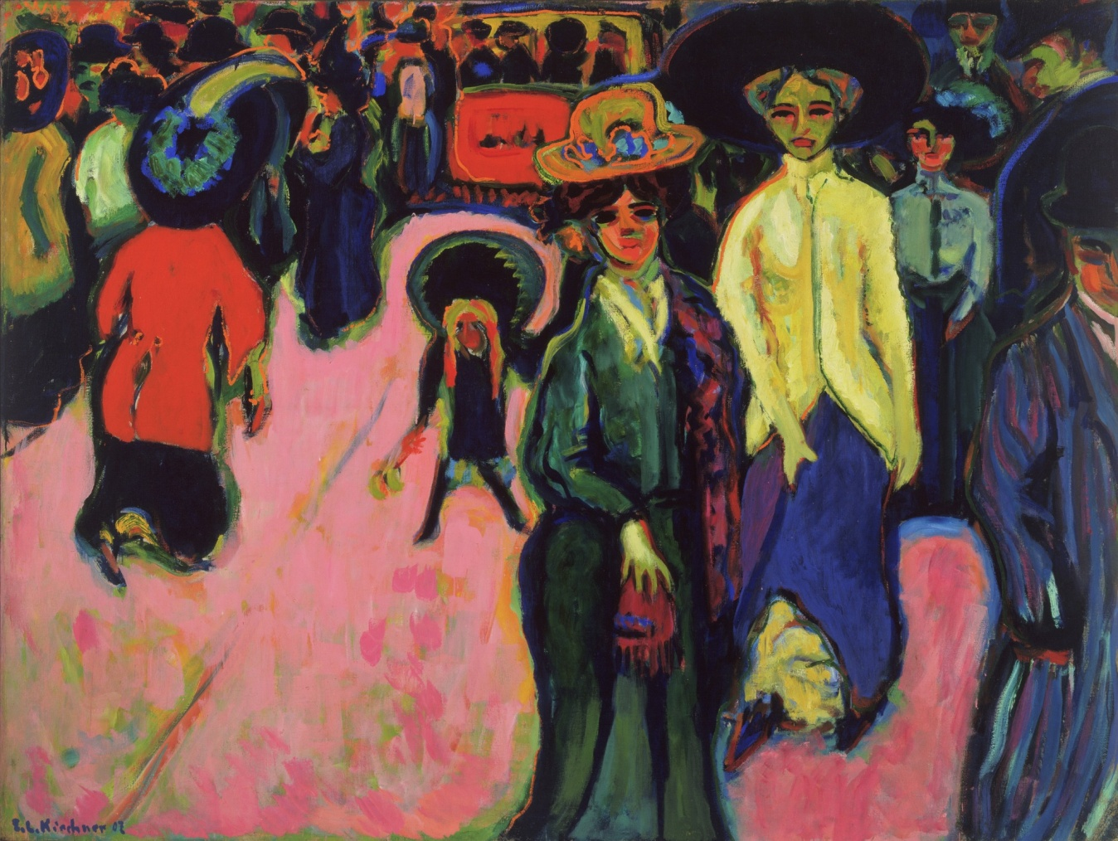
ERNST LUDWIG KIRCHNER
“Street, Dresden”
(1907)

Slide 6
ERNST LUDWIG KIRCHNER
“Schlemihl Meets His Shadow”
(1915–16)

Slide 7
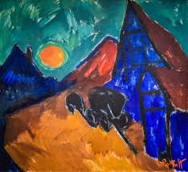
KARL SCHMIDT-ROTTLUFF
“Rising Moon”
(1912)

Slide 8
KARL SCHMIDT-ROTTLUFF
“Landscape with Houses”
(1921)
Watercolour and Indian ink on blank postcard

Slide 9
Influences of Die Brücke
Russian and Scandinavian literature
Vincent Van Gogh (Post Impressionism)
Paul Gauguin (Synthetism)
Edvard Munch (Symbolism)

Slide 10
Der Blaue Reiter (The Blue Rider)
(1911 – 1914)
“Our object is to show, in the variety of forms represented,
how the inner desire of artist realizes itself in multiple fashion.”
- Vassily Kandinsky

Slide 11
The innovations of particular members, such as the Russian Vassily Kandinsky (1866-1944) and Franz Marc (1880-1916) are notable.
Kandinsky recounted in 1930 how the group’s name came to be chosen:
“Franz Marc and I chose this name as we were having coffee one day on the shady terrace of Sindelsdorf. Both of us liked blue, Marc for horses, I for riders. So the name came by itself.”

Slide 12
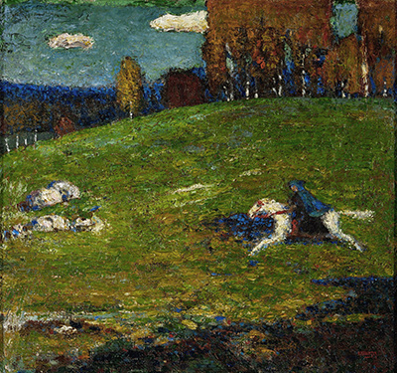
VASSILY KANDINSKY
“Blue Rider”
(1903)

Slide 13
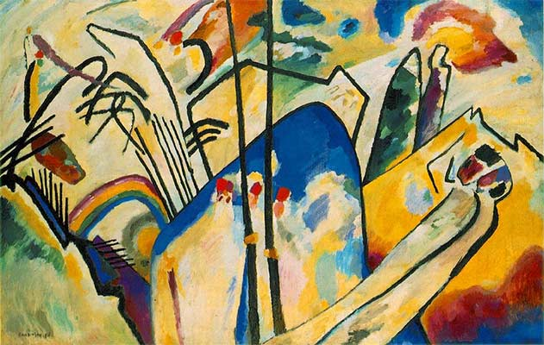
VASSILY KANDINSKY
“Kunstsammlung Nordrhein-Westfallen, Dusseldorf”
(1911)

Slide 14
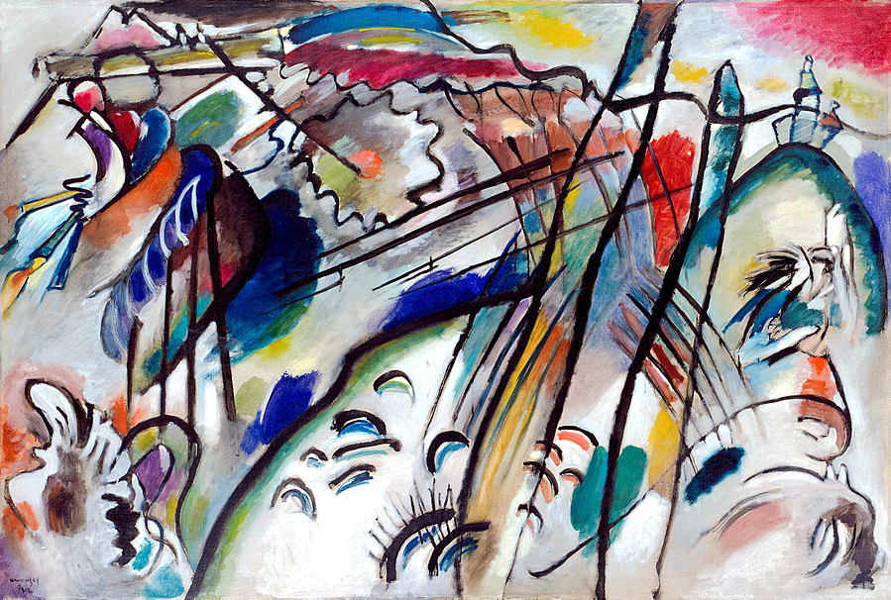
VASSILY KANDINSKY
“Improvisation 28”
(1912)

Slide 15
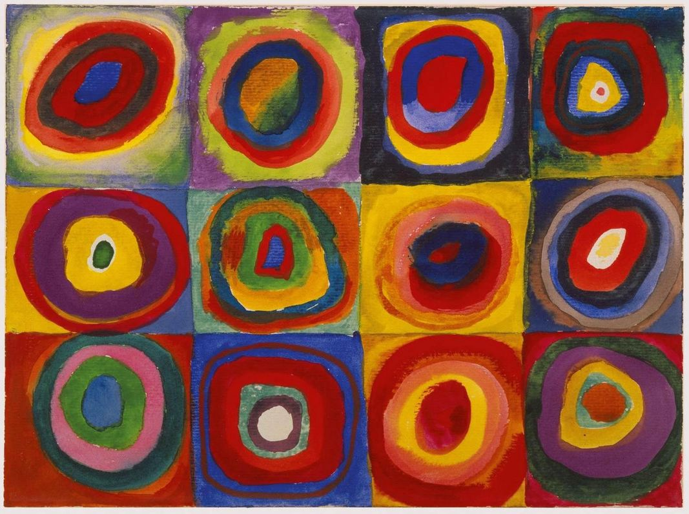
VASSILY KANDINSKY
“Color Study. Squares with Concentric Circles”
(1913)
Watercolor, gouache and crayon on paper

Slide 16
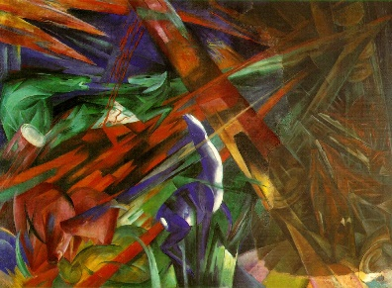
FRANZ MARC
“Fate of the Animals”
(1913)

Slide 17
FRANZ MARC
“The Unfortunate Land of Tyrol”
(1913)

